Slide 1

📚 Library Database Analysis
(Using MySQL)
Name - Aravind Marikanti
Batch.No - 539

Slide 2
About me :
Background:
Bachelor of Technology (B.Tech) in Electronics and Communication Engineering (ECE) . Graduated with a strong foundation in analytical thinking, problem-solving, and programming concepts.
Why I Want to Learn Data Science:
Passionate about working with data to uncover meaningful insights and support data-driven decision-making. Looking to enhance my technical skills and build a successful career as a Data Scientist.
Work Experience:
                Data Analyst at Survey Sampling International (SSI)
Cleaned, validated, and transformed data to tables to ensure accuracy and consistency for reporting.
LinkedIn and GitHub profile URLs
LinkedIn: https://www.linkedin.com/in/aravind155
GitHub: https://github.com/Aravind25Marikanti/Library-Database-Analysis-using-MySQL

Slide 3
Agenda :
• Introduction & Project Overview
• Project Objectives
• Technology Stack
• Database / Dataset Overview
• Database Schema / ER Diagram
• SQL Queries & Analysis
• Key Insights
• Challenges
• Conclusion
• Thank you

Slide 4
Introduction & Project Overview
Project Overview
This project focuses on creating and analyzing a library database using MySQL. The database connects books, authors, publishers, library branches, borrowers, book copies, and book loans tables.
Core Focus
Creating Database
Creating Tables
Managing Database
Analysing Database
Purpose
Use relational database queries to answer practical library-management questions and retrieve information about book availability, borrowing activity, branches, and loans etc.,

Slide 5
Project Objectives
Determine the number of copies of a specific book available at library branches.
Compare book-copy availability across branches.
Identify borrowers who do not have books checked out.
Retrieve loan details based on branch and due date.
Calculate the total number of books loaned from each branch.
Identify borrowers who have more than five books checked out.
Analyze Stephen King books and their copies at the Central branch.

Slide 6
Technology Stack
MySQL
Relational database management system used to create tables and execute SQL queries.
SQL
Used for data retrieval, filtering, joining, grouping and aggregation.
Relational Database
Primary keys and foreign keys establish relationships between tables.
Joins & Relationships
Connect related information from tables. Joins used to combine tables
Aggregate & Clauses
COUNT(), GROUP BY and HAVING etc., support analysis on the tables.

Slide 7
Database / Dataset Overview
Tables in the Database
tbl_publisher
tbl_book
tbl_book_authors
tbl_library_branch
tbl_book_copies
tbl_borrower
tbl_book_loans
Created the required tables according to the project schema.
Checked whether imported column names matched the supplied CSV files.
Defined primary-key constraints for the main entities.
Defined foreign-key constraints to establish table relationships.
Prepared the database for the seven analysis questions.

Slide 8
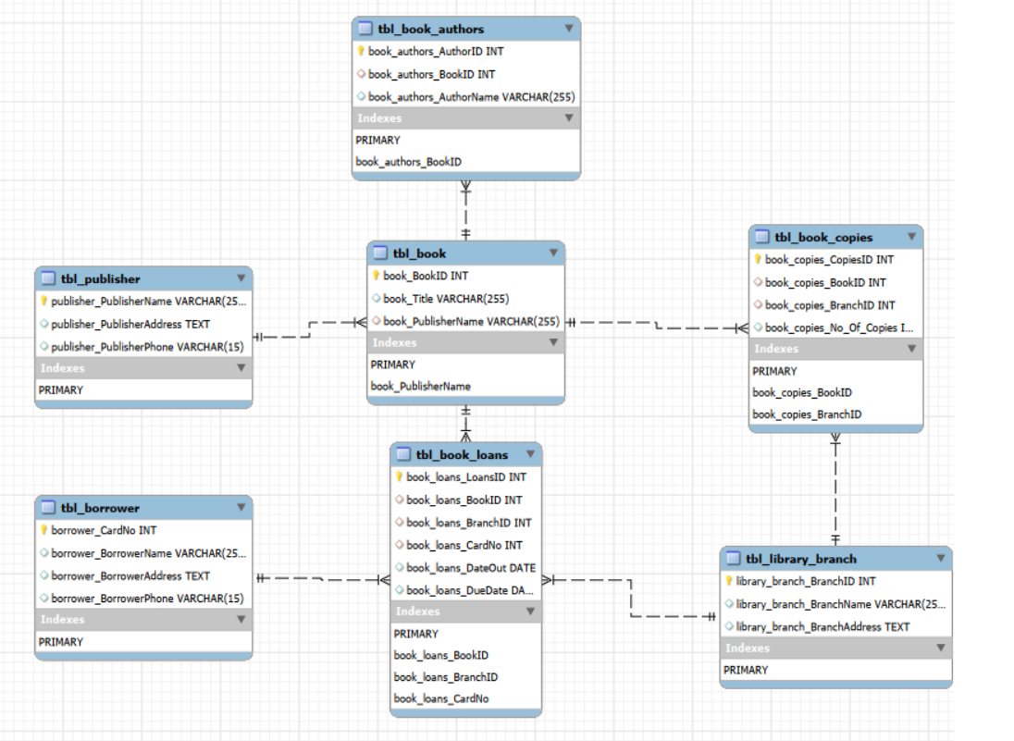
Database Schema / ER Diagram

Slide 9
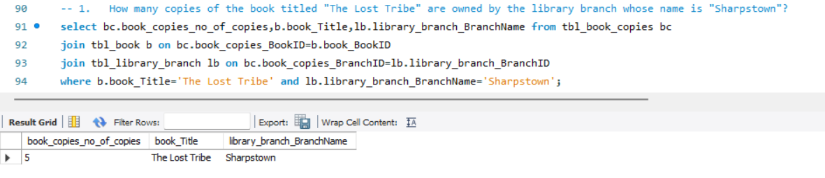
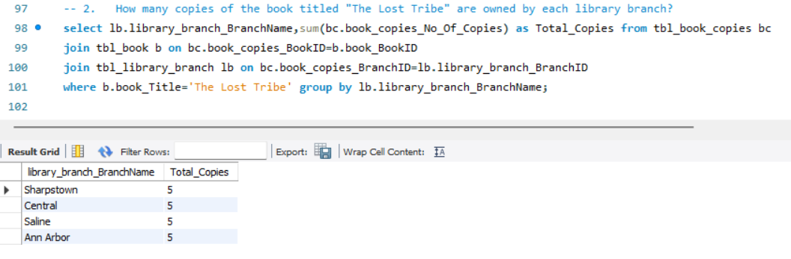
SQL Queries & Analysis
Questions 1 & 2
How many copies of the book titled "The Lost Tribe" are owned by the library branch whose name is "Sharpstown"?
How many copies of the book titled "The Lost Tribe" are owned by each library branch?
RESULT
RESULT
There are 5 copies of the book titled "The Lost Tribe" are owned by the library branch whose name is "Sharpstown"
5 copies of the book titled "The Lost Tribe" are owned by each library branch

Slide 10
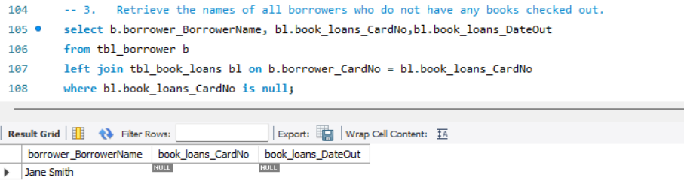
Question 3
Retrieve the names of all borrowers who do not have any books checked out.
RESULT
“Jane Smith” is the only borrower who don’t have any books checked out

Slide 11
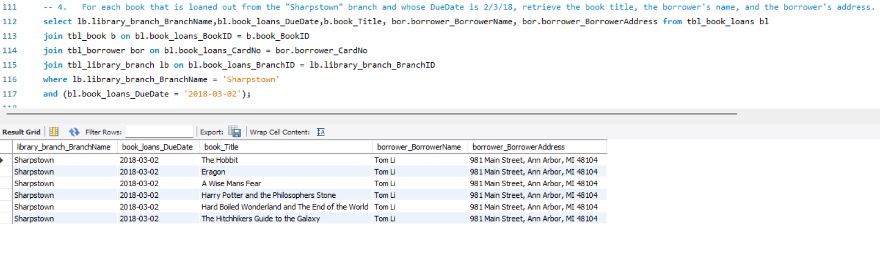
Question 4
For each book that is loaned out from the "Sharpstown" branch and whose DueDate is 2/3/18, retrieve the book title, the borrower's name, and the borrower's address.
RESULT
There are 6 books total as we seen in above output table who taken book from "Sharpstown" branch and whose DueDate is 2/3/18

Slide 12
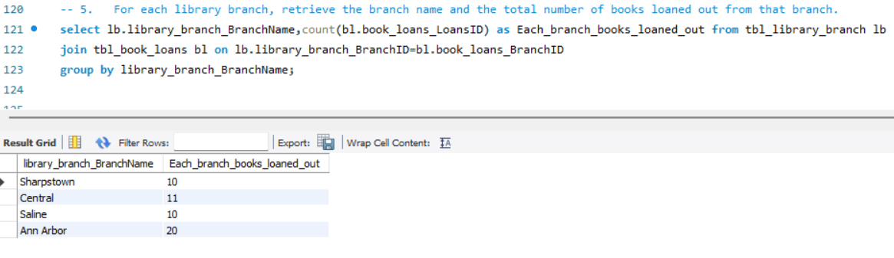
Question 5
For each library branch, retrieve the branch name and the total number of books loaned out from that branch.
RESULT
Books loaned out from each branch are Sharpstown-10, Central-11, Saline-10, Ann Arbor-20

Slide 13
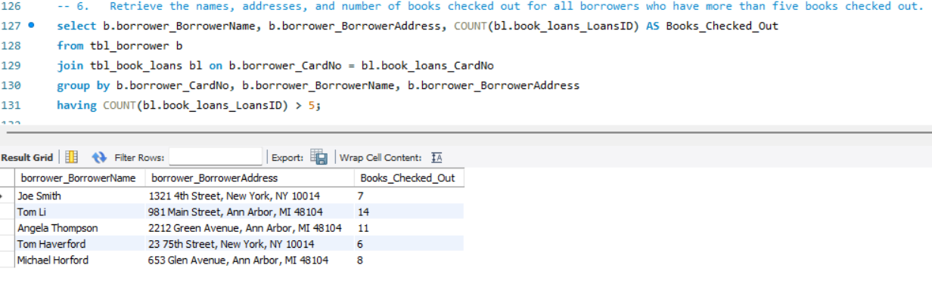
Question 6
Retrieve the names, addresses, and number of books checked out for all borrowers who have more than five books checked out.
RESULT
Total of 6 members, checked out with more than five books. We can find names, addresses in above table

Slide 14
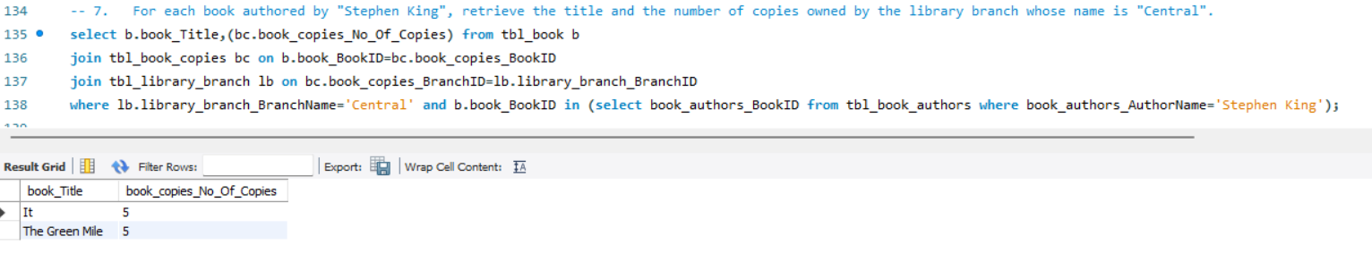
Question 7
For each book authored by "Stephen King", retrieve the title and the number of copies owned by the library branch whose name is "Central".
Books authored by “Stephen King” are “It”, “The Green Mile”. Each book has 5 copies at “Central” library branch.
RESULT

Slide 15
Key Insights
SQL Analysis
Used SQL queries to answer the seven project questions.
RESULT-1
RESULT-4
There are 5 copies of the book titled "The Lost Tribe" are owned by the library branch whose name is "Sharpstown"
There are 6 books total who taken book from "Sharpstown" branch and whose DueDate is 2/3/18
RESULT-2
RESULT-5
5 copies of the book titled "The Lost Tribe" are owned by each library branch
Books loaned out from each branch are Sharpstown-10, Central-11, Saline-10, Ann Arbor-20
RESULT-3
RESULT-6
“Jane Smith” is the only borrower who don’t have any books checked out
Total of 6 members, checked out with more than five books.
Books authored by “Stephen King” are “It”, “The Green Mile”. Each book has 5 copies at “Central” library branch.
RESULT-7

Slide 16
Challenges
⚡ Challenges Faced
Understanding the relationships between multiple tables.
Writing queries involving multiple JOINs and conditions.
Working with GROUP BY and aggregate functions for analysis.
Understanding and implementing subqueries.
Validating SQL query results to ensure the output was correct

Slide 17
Conclusion
The Library Database Analysis project demonstrates the use of MySQL for practical relational-database analysis. The database connects publishers, books, authors, branches, copies, borrowers and loans.
SQL queries can retrieve and summarize information across multiple related tables.
The seven project questions provide analysis of book availability, borrowing activity, branch loans and author-specific inventory.
The project strengthened practical skills in database creation, relationships and SQL-based analysis.

Slide 18

THANK YOU

